Slide 1

Home
About Us
Service
Contact
Todo List
Application
Todo List
Application
PRESENTER : MARLIANTI BT MUF PIARLIS S66353
PRESENT TO : DR. RABIEI B MAMAT
Youtube Link: https://youtu.be/lkGkD_nyrnA

Slide 2
Home
About Us
Service
Contact
Introduction
Todo List is a app designed to help user manage their daily task more efficiently and improve productivity
This app allow user to create, update and delete their task with ease
Todo List
Application

Slide 3
Home
About Us
Service
Contact
Problem Statement
1
2
Paper-based risk of loss information
Struggle to keep track the datelines
3
Paper-based are static making it difficult to organize the task
Todo List
Application

Slide 4
Home
About Us
Service
Contact
Objectives
Platform that user can access their to-do list from any devices, ensuring their task safe from physical damage and loss
The checked featured for the task so users can keep track their tasks
To enhance the task management. This app will provide users with robust platform to create, update, delete and rearrange tasks.
Todo List
Todo List
Application
Application
Todo List
Application
Todo List
Application

Slide 5
APPLICATION DEMOSTRATION

Slide 6
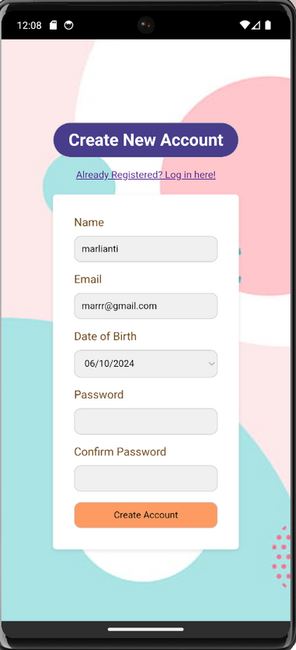
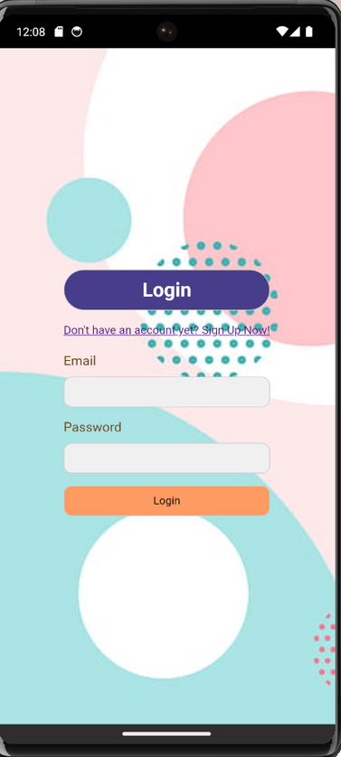
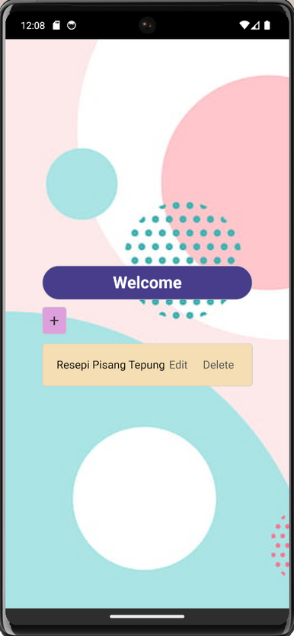
SignUp Page
Login Page
Index Page

Slide 7
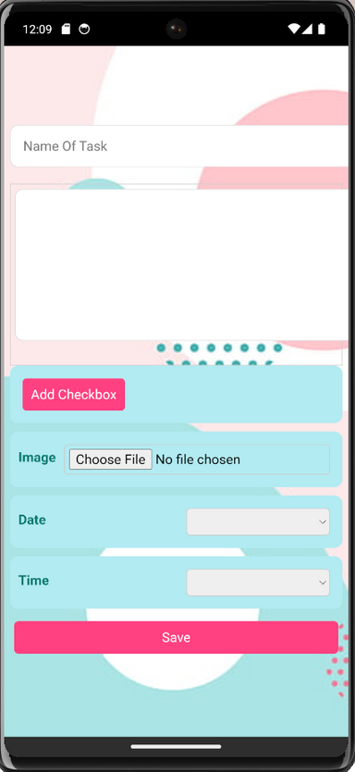
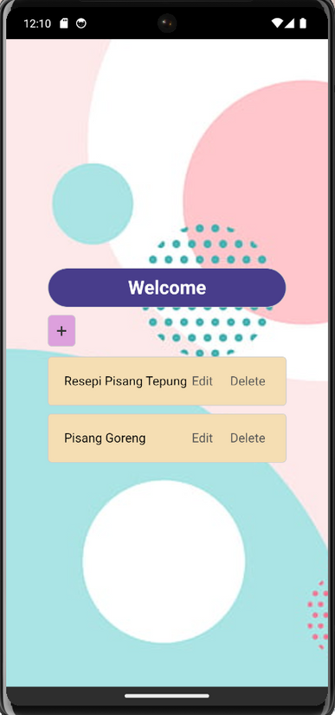
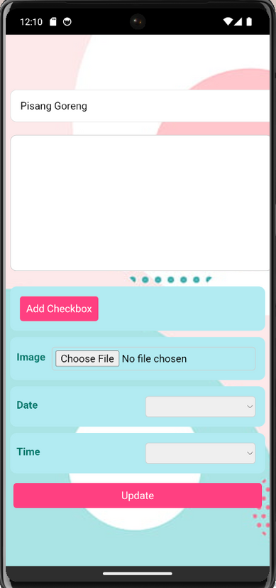
Create Task
After Being Create
Edit Page

